Slide 1

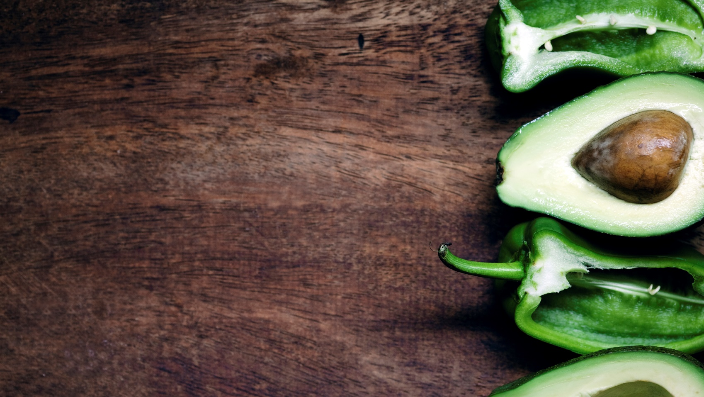
The food detectives
Senior Project Presentation

Slide 2
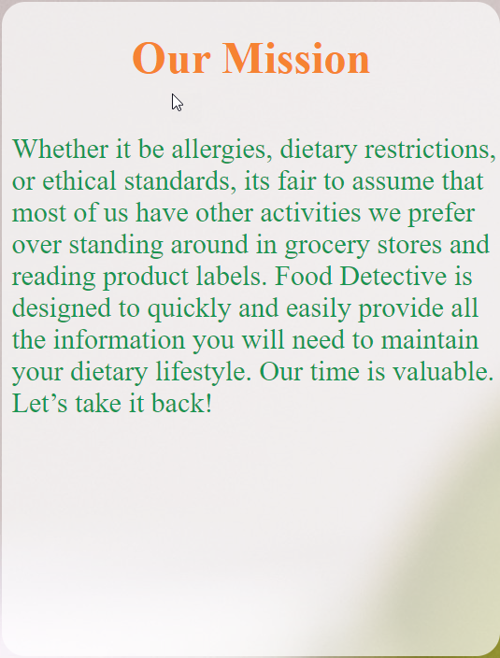

Mission Statement
Whether it be allergies, dietary restrictions, or ethical standards, it's fair to assume that most of us have other activities we prefer over standing around in grocery stores and reading product labels. Food Detective is designed to quickly and easily provide all the information you will need to maintain your dietary lifestyle. Our time is valuable. Let’s take it back!

Slide 3
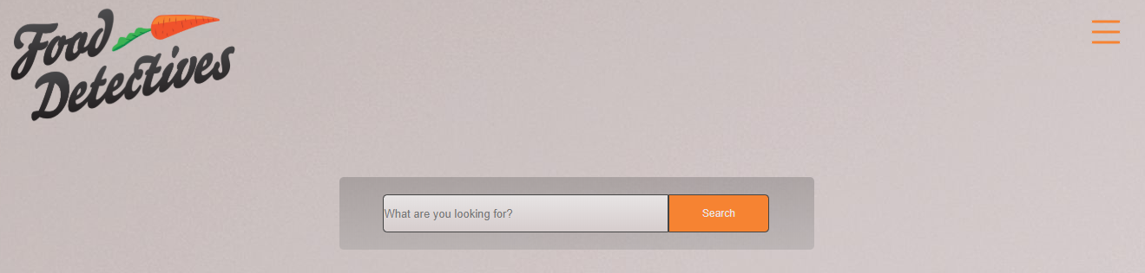
Project Overview
The Food Detectives website allows users to determine the following:
Diet types food falls under
Avoid possible allergy conflicts
View all nutritional values for a given food ( Logged in)
Save favorites so users can quickly review their favorite foods (Logged in)

Slide 4


Brian – Primary Back-end developer
What I have learned:
3rd party API's
Dynamic pages

Slide 5
Dercio – Primary Front-End developer
What I have learned:
Learn more about JavaScript
Being more proficient using GitHub
Communication skills

Slide 6
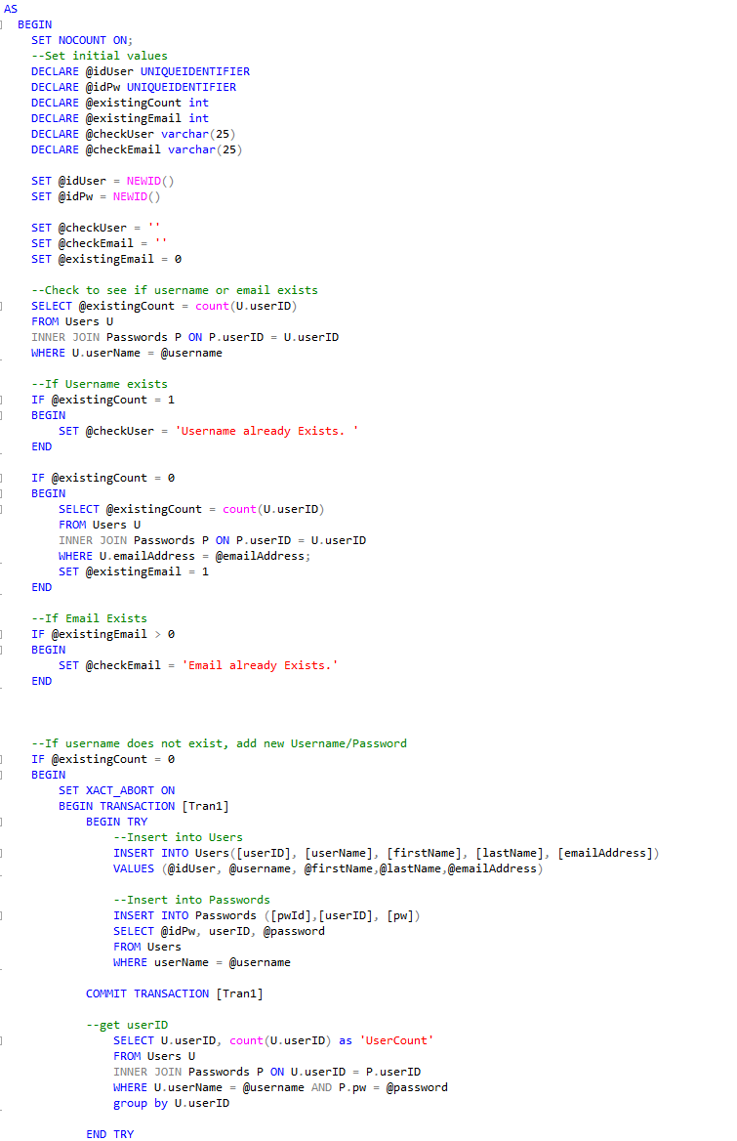
Michael – Primary Database developer
What I have learned:
Improved T-SQL skills
Deploying Web apps
Patience about the process

Slide 7
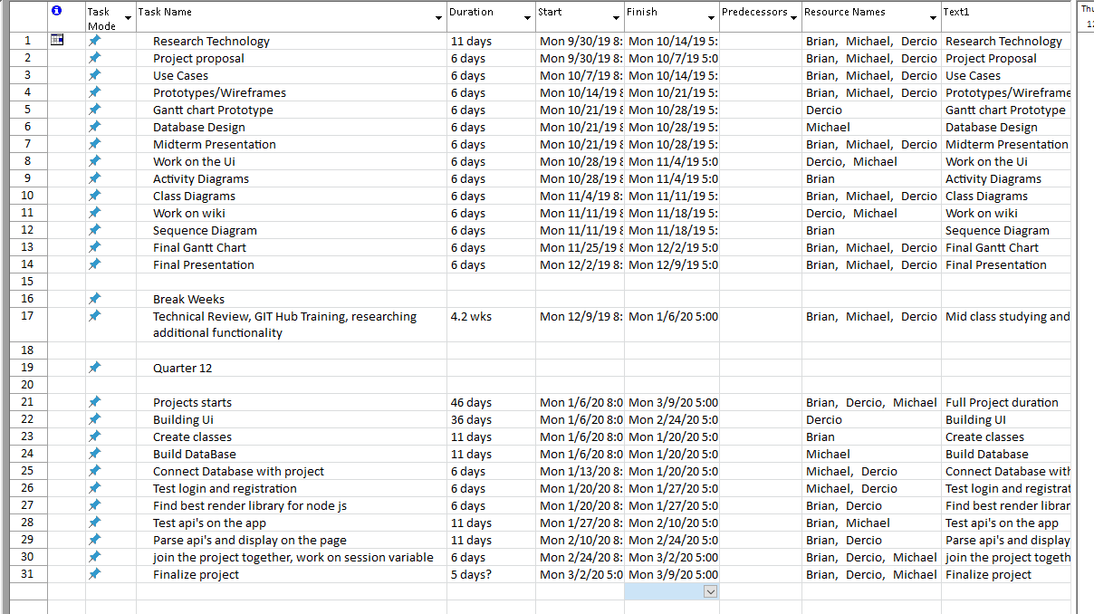

Project Timeline

Slide 8
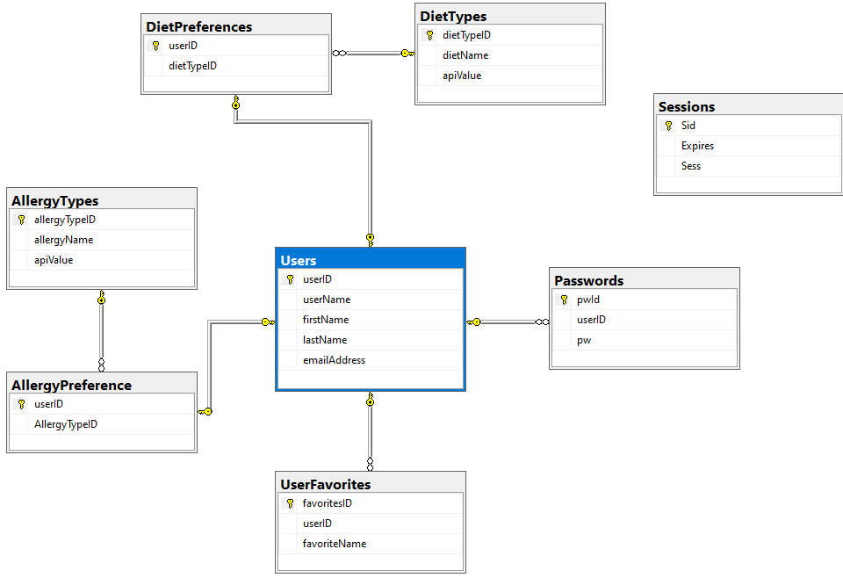
Database organization

Slide 9
Obstacles overcome
Understanding Stack
Clear Separation of Roles
Deploying NodeJS application

Slide 10





Technical Design

Slide 11

Project Summary
The Food Detectives project:
A difficult technical exercise due to tech stack
Unable to complete all MVP pieces
A group project that allowed us to understand the importance of working together

Slide 12
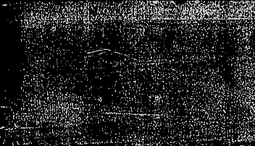
Thank you
Any Questions?
http://fooddetectives2.herokuapp.com/

